Slide 1
The Art of Thinking Differently in Babylon Dr. Simon Mould PBC President

Slide 2
The Art of Thinking Differently in Babylon
“See to it that no one takes you captive by philosophy and empty deceit, according to human tradition.”
(Col. 2:8)
“Timothy, protect what has been entrusted to you, avoiding worldly, empty chatter and the opposing arguments of what is falsely called “knowledge” which some have professed and thereby have gone astray from the faith.”
(1 Tim. 6:20-21)
“Do not be conformed to this world, but be transformed by the renewal of your mind, that by testing you may discern what is the will of God, what is good and acceptable and perfect.”
(Rom. 12:2)
Notes:
Information is a vehicle for philosophy
Renewal of mind: by testing and discernment = critical thinking. Not just laying on of hands
________________________________________________
We live in an information age…

Slide 3
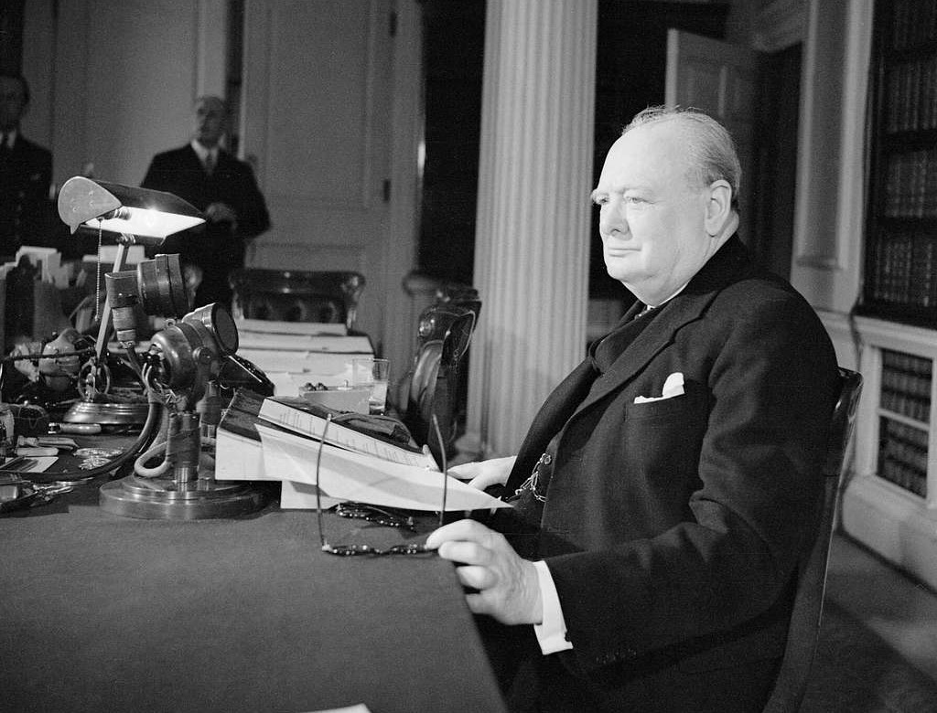
“The empires of the future are the empires of the mind.” Winston Churchill, Harvard Commencement Address, 1943.
Notes:
________________________
Gen. Z – 1st generation …

Slide 4
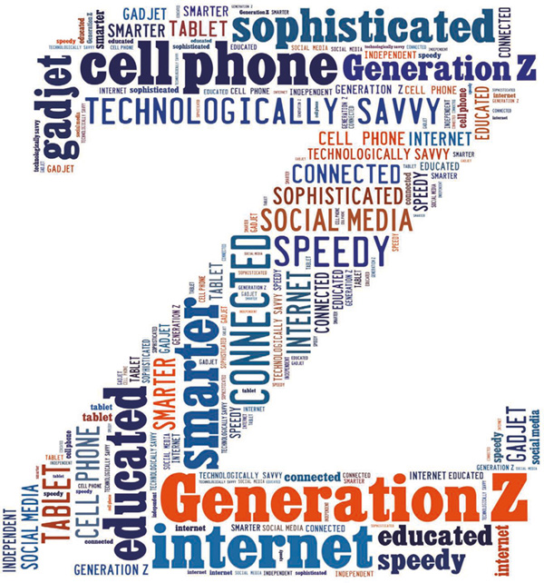
Gen Z: Emerging in an Information Age
Digital natives.
Came of age with social media.
Entered college during digital dependency.
Entered the workforce during the AI revolution.

Slide 5
Every 24 hours:
329 million terabytes of information is generated per day.
333 billion emails are sent.
8.5 billion Google searches.
3.5 billion snaps on Snapchat.
2.45 billion pieces of content posted to Facebook.
1.58 billion swipes on Tinder.

Slide 6
Recognizing Disinformation as a Currency of Manipulation
To gain power, the intent of creators and spreaders of disinformation is to:
Intellectually discredit.
Emotionally manipulate.
Socially polarize.
Notes:
Intellectually discredit: A technique to deflect attention away from facts or create alternative realities with lies. ‘Fake news’: a rhetorical device used to dismiss and discredit facts that don’t align with a person’s actions or values.
Emotionally manipulate: Disinformation deliberately plays on people's emotions by inciting fear and anger. Putting people into an emotional state significantly increases their susceptibility to believing fake information.
Socially polarize: A technique to deliberately drive a wedge between different sectors of society. Political, social, economic division.
_____________
Growing concern around the tendency for disinformation to feed social groups to dislike or hate each other at a personal level.

Slide 7
Recognize the Tools of Disinformation Manipulators
To gain power, the tools of the manipulators is to create content designed to :
Generate emotional appeal
Provide an echo chamber that appeals to confirmation bias

Slide 8
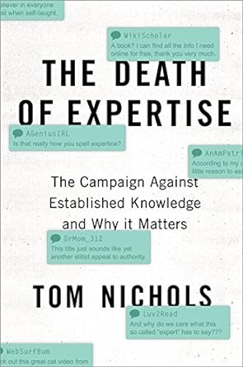
“Confirmation bias is the tendency to look for information that only confirms what we believe, to accept facts that only strengthen our preferred explanations, and to dismiss data that challenge what we already accept as truth.”

Slide 9
Recognize the Tools of Disinformation Manipulators
To gain power, the tools of the manipulators is to create content designed to :
Generate emotional appeal
Provide an echo chamber that appeals to confirmation bias
Validate exaggerated fears

Slide 10
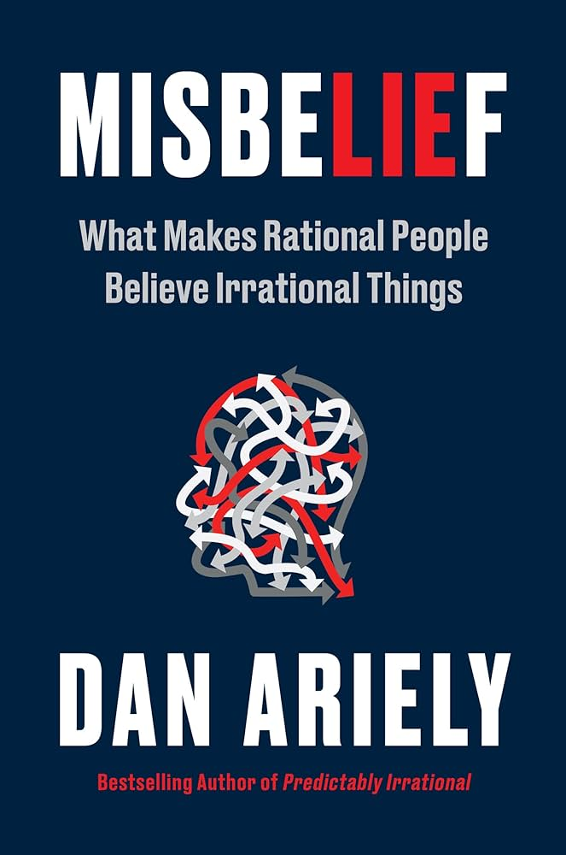
“Sometimes we willingly distort our perception of the evidence for social purposes, because we have a deep need to belong and identify with like-minded others.”
“Powerful social forces attract people to change their minds, lead them down specific paths, keep them among fellow misbelievers, and even accelerate the extremity of their beliefs. A sense of community and belonging is a powerful draw and is particularly important in cases where people feel disconnected or ostracized from mainstream society.”

Slide 11
“The reason why conspiracy theories spread so easily is because they are psychologically attractive; they offer simple explanations for complex events; they restore a sense of urgency and control in a world, increasingly filled with chaos and uncertainty.”

Slide 12
The Daniel Model of Building Understanding and Wisdom
“Then the king commanded…to bring some of the people of Israel…those skillful in all wisdom, endowed with knowledge, understanding learning, and competent to stand in the king's palace, and to teach them the literature and language of the Chaldeans…As for these four youths, God gave them learning and skill in all literature and wisdom.” (Dan. 1:4, 17).
Notes:
How do we return real value to knowledge? We need a biblical model.

Slide 13
Daniel’s intellectual virtues:
Virtue | Intellectual Action | Modeled by Daniel
Curiosity | Disposition to wonder and ask why. | Daniel asked the captain of the king’s guard, “why is this decree so urgent?” (Dan. 2:15).
Autonomy | Capacity for active, self-directed thinking. An ability to think and reason for oneself. | Daniel knew that reliance on the intellectual elite was not possible. (Dan. 2:27-28).
Courage | Readiness to persist in thinking or communicating in the face of fear. | Daniel volunteered to discern the kings dream in the face of death. (Dan. 2:16).
Humility | Willingness to own one’s intellectual limitations and mistakes. To be unconcerned with intellectual status of prestige. | Daniel did not take credit for his insight. (Dan. 2:23).
Open-mindedness | Ability to provide and receive a fair and honest consideration of different views. A willingness to change opinion if and when necessary. | Daniel had skill in understanding the literature of the Babylonians. (Dan. 17)

Slide 14
Daniel’s intellectual skills:
Learning Skill | Learning Objective
Discern | To understand the authority or intent of information
Distinguish | To understand the accuracy of information.
Consider | To recognize the application of information.

